Slide 1
BCS 370 Data Structures
Arthur Hoskey, Ph.D.
Farmingdale State College
Computer Systems Department

Slide 2
Today’s Lecture
Chapter 8 ADT Binary Search Trees
Created By Arthur Hoskey, PhD

Slide 3
Goals
Define and use the following terminology: binary tree root descendant subtree binary search tree
parent level ancestor
child height
Define a binary search tree at the logical level
Show what a binary search tree would look like after a series of insertions and deletions

Slide 4
Goals
Implement the following binary search tree algorithms in C++
    Inserting an element
    Deleting an element
    Retrieving an element
    Modifying an element
    Copying a tree
    Traversing a tree in preorder, inorder, postorder

Slide 5
Goals
Discuss the Big-O efficiency of a given binary search tree operation
Describe an algorithm for balancing a binary search tree
Show how a binary tree can be represented in an array, with implicit positional links between the elements
Define the terms full binary tree and complete binary tree

Slide 6
Trees
Owner
Jake
Manager Chef Brad Carol
Waitress Waiter Cook Helper
Joyce Chris Max Len
Jake’s Pizza Shop

Slide 7
Trees
Owner
Jake
Manager Chef Brad Carol
Waitress Waiter Cook Helper
Joyce Chris Max Len
ROOT NODE

Slide 8
Trees
Owner
Jake
Manager Chef Brad Carol
Waitress Waiter Cook Helper
Joyce Chris Max Len
LEAF NODES

Slide 9
Trees
Owner
Jake
Manager Chef Brad Carol
Waitress Waiter Cook Helper
Joyce Chris Max Len
LEVEL 0

Slide 10
Trees
Owner
Jake
Manager Chef Brad Carol
Waitress Waiter Cook Helper
Joyce Chris Max Len
LEVEL 1

Slide 11
Trees
Owner
Jake
Manager Chef Brad Carol
Waitress Waiter Cook Helper
Joyce Chris Max Len
LEVEL 2

Slide 12
Trees
Owner
Jake
Manager Chef Brad Carol
Waitress Waiter Cook Helper
Joyce Chris Max Len
LEFT SUBTREE OF ROOT NODE

Slide 13
Trees
Owner
Jake
Manager Chef Brad Carol
Waitress Waiter Cook Helper
Joyce Chris Max Len
RIGHT SUBTREE
OF ROOT NODE

Slide 14
Binary Tree
Binary Tree
A structure with a unique starting node (the root), in which each node is capable of having two child nodes and a unique path exists from the root to every other node
Root
The top node of a tree structure; a node with no parent
Leaf Node
A tree node that has no children

Slide 15
Binary Tree
Binary Tree
Unique starting node (Root)
Each node capable of having two children
Unique path from root to all other nodes
Root
52
21
77
11
33
56
88
Leaf Nodes
Created By Arthur Hoskey, PhD

Slide 16
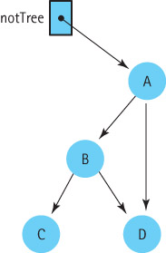
Trees
Why is
this
not a
tree
?

Slide 17
Trees
Why is
this
not a
tree
?
Answer:
No unique path
from root to item D

Slide 18
Binary Search Tree
Binary Search Trees (BST)
Search Property
A binary tree in which the key value in any node is greater than the key value in the left child and any of its children and less than the key value in the right child and any of its children
A BST is a binary tree with the search property.

Slide 19
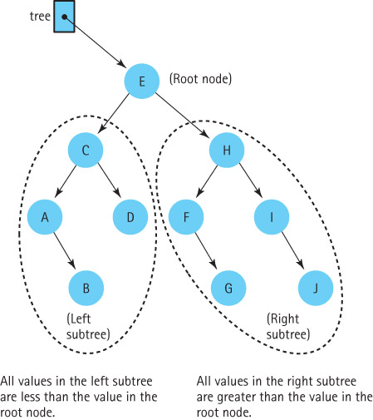
Binary Search Trees
Each
node is
the
root of a
subtree

Slide 20
Binary Search Tree
Is this a binary search tree?
Root
52
21
77
99
33
56
88
Leaf Nodes
Created By Arthur Hoskey, PhD

Slide 21
Binary Search Tree
Root
No!
99 Violates the search property.
52
21
77
99
33
56
88
Leaf Nodes
Created By Arthur Hoskey, PhD

Slide 22
Binary Search Tree
Is this a binary search tree?
Root
52
21
77
11
33
56
88
Leaf Nodes
Created By Arthur Hoskey, PhD

Slide 23
Binary Search Tree
Yes. This is a binary search tree
Root
52
21
77
11
33
56
88
Leaf Nodes
Created By Arthur Hoskey, PhD

Slide 24
Binary Search Tree
Level
The distance of a node from the root; the root is level 0.
Height
The maximum level.

Slide 25
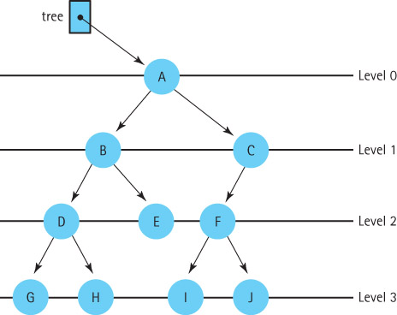
Trees
Level
Distance of
a node from
the root
Height
The
maximum
level

Slide 26
Trees
How many leaf
nodes?
Q
E
S
A
L
T
K
V

Slide 27
Trees
How many leaf
nodes?
Answer: 3
Q
E
S
A
L
T
K
V

Slide 28
Trees
Descendants
These are the children of a given node. For any given node, say n, the descendants of n are all of the children of n and all of the children of the children of n and so on.
Ancestors
A node is the ancestor of another node if it is the parent of that node, or the parent of some other ancestor of that node.

Slide 29
Trees
E has how many
descendants?
Q
E
S
A
L
T
K
V

Slide 30
Trees
E has how many
descendants?
Answer: 3
Q
E
S
A
L
T
K
V

Slide 31
Trees
V has how many
ancestors?
Q
E
S
A
L
T
K
V

Slide 32
Trees
V has how many
ancestors?
Answer: 3
Q
E
S
A
L
T
K
V

Slide 33
Binary Search Tree
What operations would be appropriate for a binary search tree?
Created By Arthur Hoskey, PhD

Slide 34
Binary Search Tree
Transformers
  InsertItem
  DeleteItem
Observers
  IsEmpty
  IsFull
  GetLength
  RetrieveItem
  Print
change state
observe state
Created By Arthur Hoskey, PhD

Slide 35
Binary Search Tree (linked)
The textbook focuses mainly on the linked implementation of a binary search tree.
What member variables do we need for a linked implementation?

Slide 36
Binary Search Tree (linked)
class TreeType {
public:
TreeType(int max);
TreeType();
~TreeType();
int GetLength() const;
void RetrieveItem(int& itme, boo& found) const;
void MakeEmpty();
bool IsEmpty() const;
bool IsFull() const;
void Print(ostream& out) const;
void InsertItem(int item);
void DeleteItem(int& item);
Logical Level

Slide 37
Binary Search Tree (linked)
private:
Node *root; // Root of the tree
// Whatever else we need
};
Implementation level

Slide 38
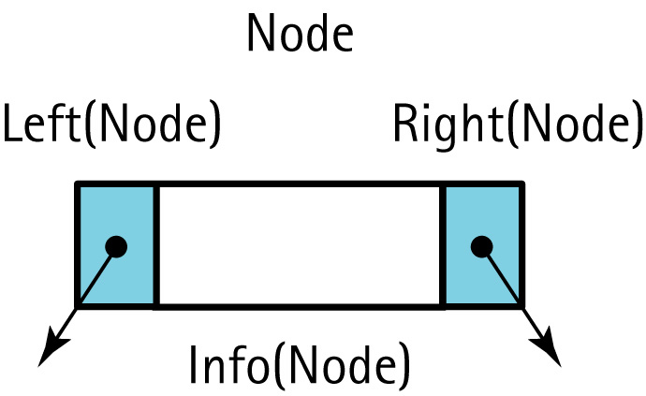
Node
Picture of a tree node

Slide 39
Node
Binary search tree node
struct Node {
int info;
Node* left;
Node* right;
};

Slide 40
Binary Search Tree (linked)
int TreeType::GetLength() const
{
return GetLength(root);
}
int TreeType::GetLength(TreeNode* tree)
{
if (tree == NULL)
return 0
else
return GetLength(tree->left) + GetLength(tree->right) + 1;
}
What should the access modifiers be for each GetLength?
Call the recursive GetLength
1. Get left subtree length
2. Get right subtree length
3. Add 1 for the current node

Slide 41
Attendance
Take attendance now!!!
Created By Arthur Hoskey, PhD

Slide 42
End of Slides
End of Slides
Created By Arthur Hoskey, PhD

